Slide 1



Open Enrollment
Effective Dates: 01/01/2026-12/31/2026

Slide 2
Overview
Open Enrollment overview
Your service team
An overview of medical plans
Medical plan terminology
Information on medical plans
Dental plan differences
Vision plan information
Short/Long term disability

Slide 3

What is Open Enrollment?
Open Enrollment is the time of year you can make changes to your benefit plans without a Qualifying Life Event.
  What is considered a Life Event?
  Marriage, divorce, birth of a newborn, loss of coverage, or gaining coverage elsewhere.
Changes made at Open Enrollment become effective January 1st.
Benefits elected at Open Enrollment cannot be changed until the next Open Enrollment, unless you experience a Qualifying Life Event.
During Open Enrollment you can:
  Add & remove dependents, cancel your coverage, and change plans.*1
*1 If you remove a dependent at open enrollment it is not a COBRA qualifying event (they will not be offered COBRA).

Slide 4
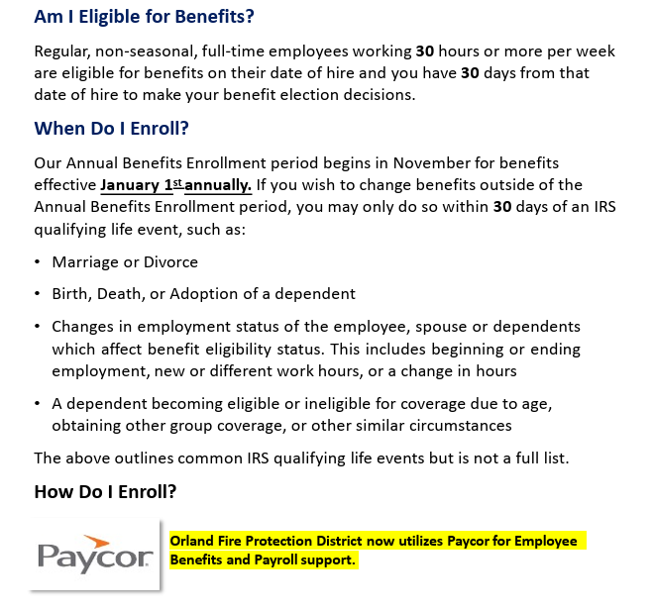
Eligibility and Enrollment

Slide 5

Your Dedicated Benefits Team
Gabriella Borrego
Phone - 630.686.1765
Orlandhealth@gaylordinsurance.com
INSURANCE CARRIER CONTACTS
HMO Insurance Plan Customer Service
BlueCross BlueShield of IL
800-892-2803
PPO & HSA Insurance Plan Customer Service
BlueCross BlueShield of IL
800-828-3116
Prescriptions Customer Service
BlueCross BlueShield of IL
833-715-0944
Specialty Pharmacy Customer Service
Accredo
866-725-2546
Dental Insurance Customer Service
BlueCross BlueShield of IL
800-367-6401
Vision Insurance Customer Service
BlueCross BlueShield of IL
855-362-5539
Life Insurance Customer Service
800-628-8600
Flexible Spending Account
FlexBenefits
888-345-7990
Medical, Dental & Vision all Inquires
Voluntary benefits
Commuter benefits
COBRA
Life Insurance
FSA/HSA/HRA plans
Life Events
Claims Assistance

Slide 6

Medical Plans

Slide 7
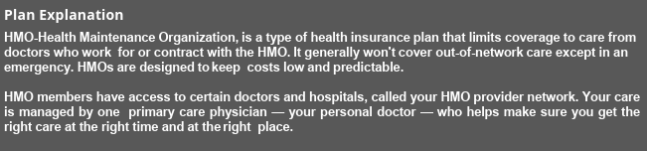
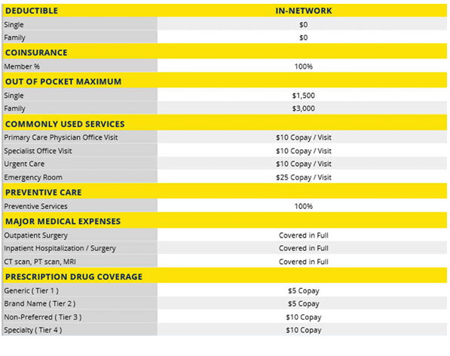
Definitions:
Deductible:
The amount you pay for health care services before your health insurance begins to pay.
Co-insurance
Co-insurance is the amount you pay for covered health care after you meet your deductible. This amount is a percentage of the total cost of care—for example, 30%—and your plan covers the rest.
Copay
A copay (or copayment) is a flat fee that you pay on the spot each time you go to your doctor or fill a prescription.
Out of Pocket Max:
The most you are required to pay for covered services in a plan year. After you spend this amount on deductibles, co-payments, and co-insurance for in-network care and services, your health plan pays 100% of the costs of covered benefits. The out-of-pocket limit does not include your monthly premiums.
Note:
The deductible and Maximum Out of Pocket are calendar year.

Slide 8

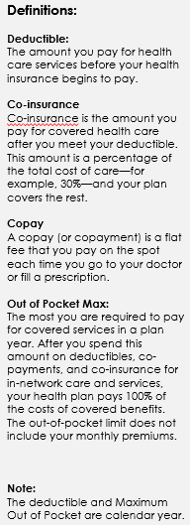
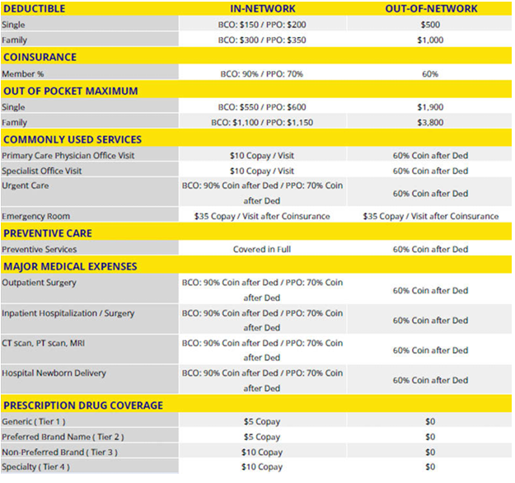

Slide 9
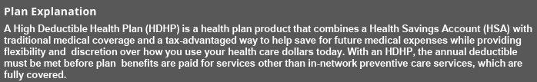
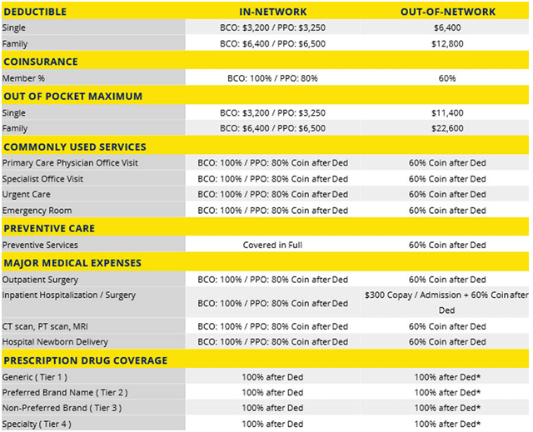

Slide 10
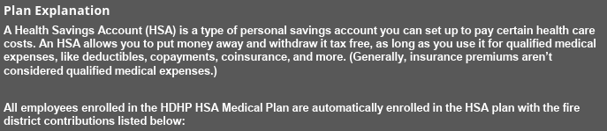
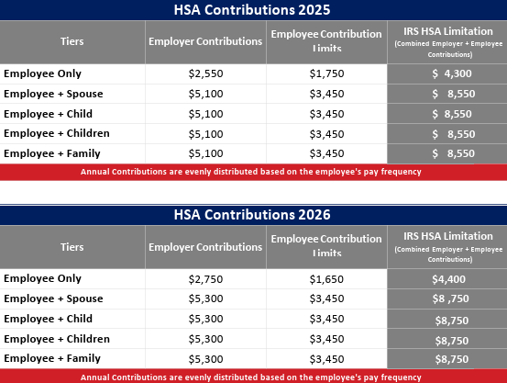
Health Savings Account

Slide 11
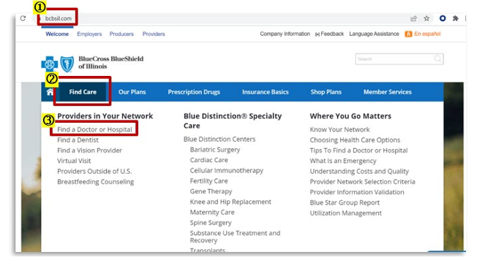
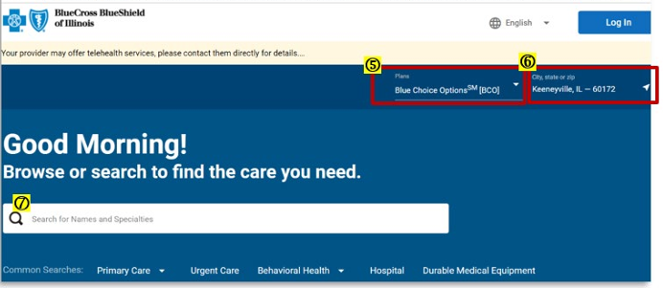
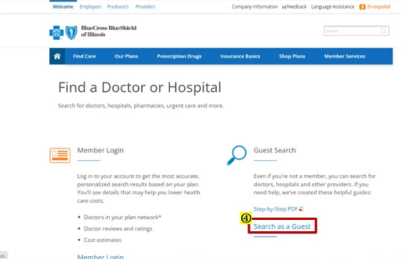
BCBS-
How to search for a provider
Go to www.bcbsil.com
Select “Find Care”
Select “Find a Doctor or Hospital”
5. Under “Plans”, select from the dropdown the network you are searching Blue Choice Select or Blue Precision HMO
6. Enter your city, state, or zip
7. Search by Doctor, Facility or Clinic Name, or Specialty. You can limit the distance by choosing a mile radius. To further your search, you can filter for accepting new patients, gender, patient ratings, etc.
4. On the right-hand side under Guest Search, click “Search as a Guest”

Slide 12


BCBS x BLUE 365
Blue365 gives Blue Cross members access to savings across all aspects of your life— including discounts on wearable devices, gym membership access starting at $19/month, discounts on healthy, organic meal delivery services from Sunbasket, and much more!
It’s an online destination where participating members can find healthy deals and exclusive discounts. All you need is your member ID card to get started.
Register now at no cost to take advantage of Blue365.

Slide 13
Dental Plan

Slide 14
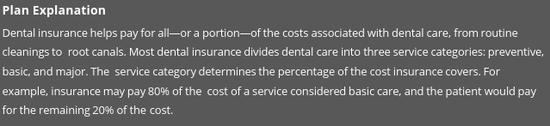
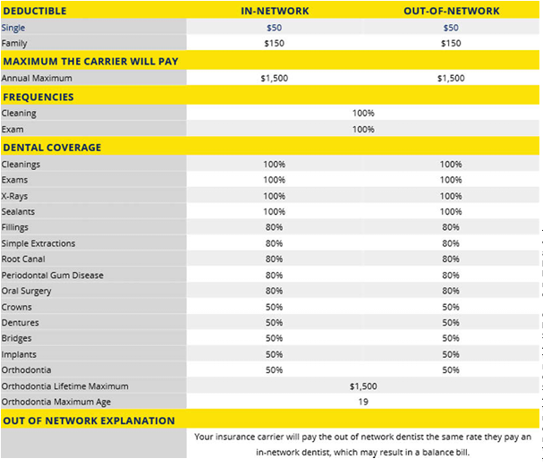

Slide 15

Vision Plan

Slide 16
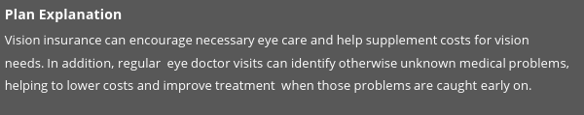
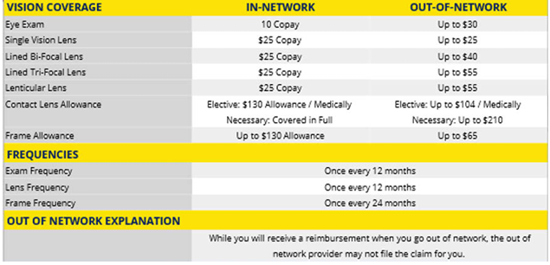
Voluntary Vision

Slide 17


HMO - Embedded Vision

Slide 18


PPO - Embedded Vision

Slide 19

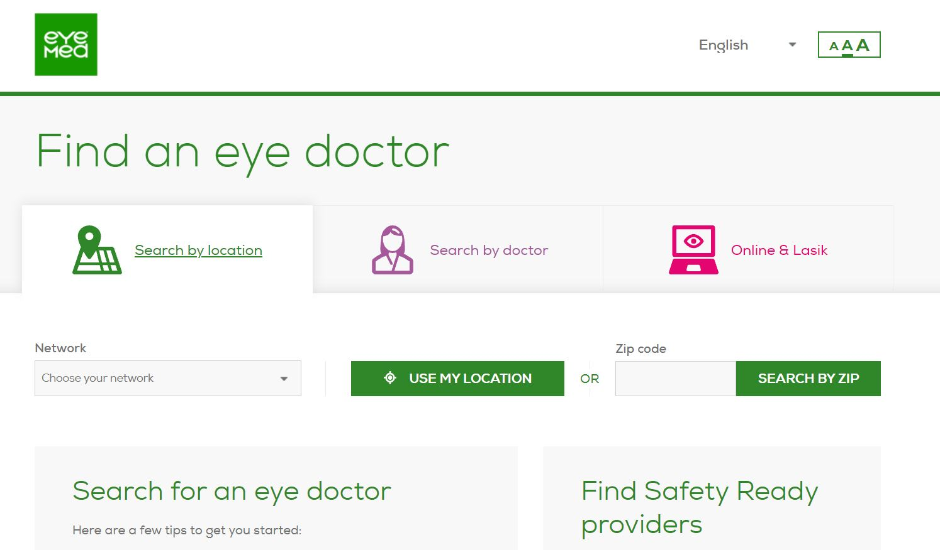
Eyemed-
How to find a provider

Slide 20

Voluntary Benefits

Slide 21
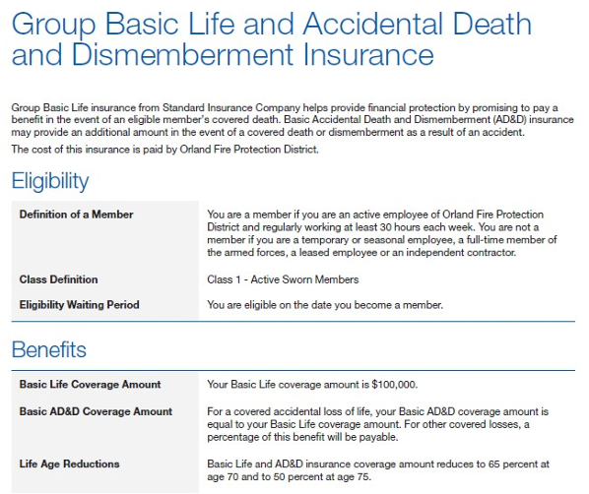
Life & AD&D- Active Sworn Members

Slide 22
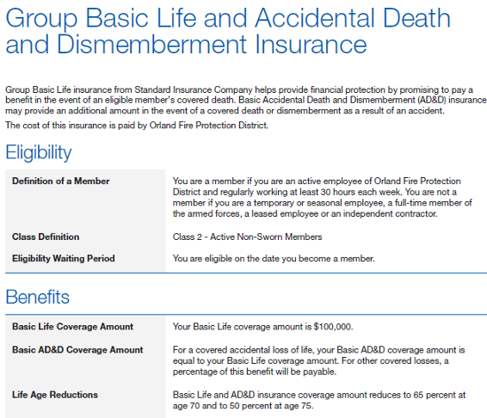
Life & AD&D- Active Non-Sworn Members

Slide 23

Flexible Spending Accounts

Slide 24
Your FSA Needs
Financial Health Care and Dependent Care Flexible Spending
FSA Health Care Flexible Spending:
Employees can set aside their own money on a pre-tax basis to pay for qualified medical expenses throughout the year.
IRS 2026 FSA contribution limits are $3,400*.
The maximum carryover amount into 2027 is $680.
FSA Dependent Care Flexible Spending:
Employees have an opportunity to set aside their own money to pay for the cost of care for dependent children or elder care for aging parents.
Annual Maximum Contribution $7,500.
*Beginning with the 2026 plan year, all Flexible Spending Account (FSA) participants must elect to contribute at least $100 annually.

Slide 25
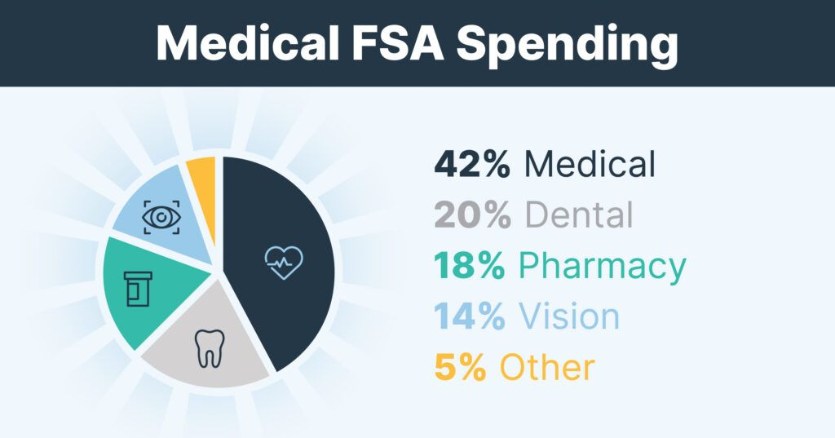
What eligible expenses can be reimbursed with a FSA?
There are so many eligible expenses available! A general-purpose medical FSA covers many eligible expenses, such as:
Doctor visits
Prescription medications
Dental care
Vision care
And more
Dependent care FSA eligible expenses include:
Child care
Day camp
Before or after school programs
Babysitting
Adult day care center
Elder care
And more

Slide 26
Open Enrollment Summary
We strongly recommend all benefits-eligible employees complete Open Enrollment.
If you do not receive the Open Enrollment email: check your spam folder, contact us or log onto the Paycom Portal.
If you have trouble logging into your employee portal, contact us for immediate assistance.
Check the confirmation page carefully to make sure you have updated dependent information and elected the plans of your choice.
Your open enrollment is complete when you click “submit” and sign electronically on the following page.
Print your confirmation page for your records.

Slide 27




Questions?

